Slide 1
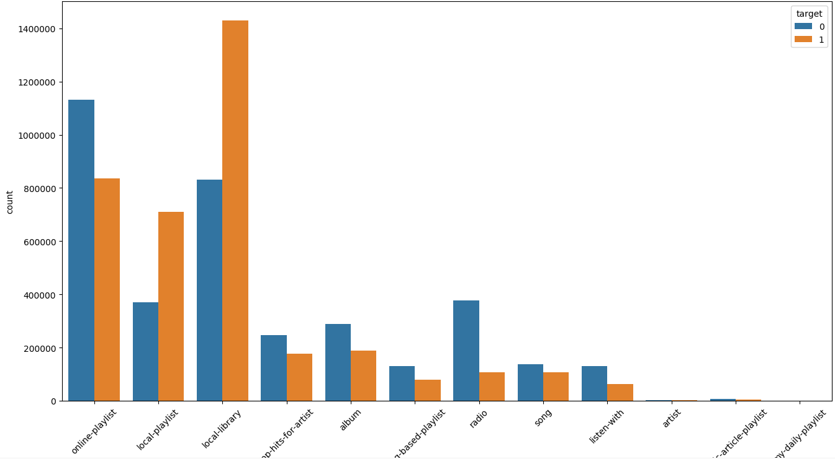
Target by source_type

Slide 2
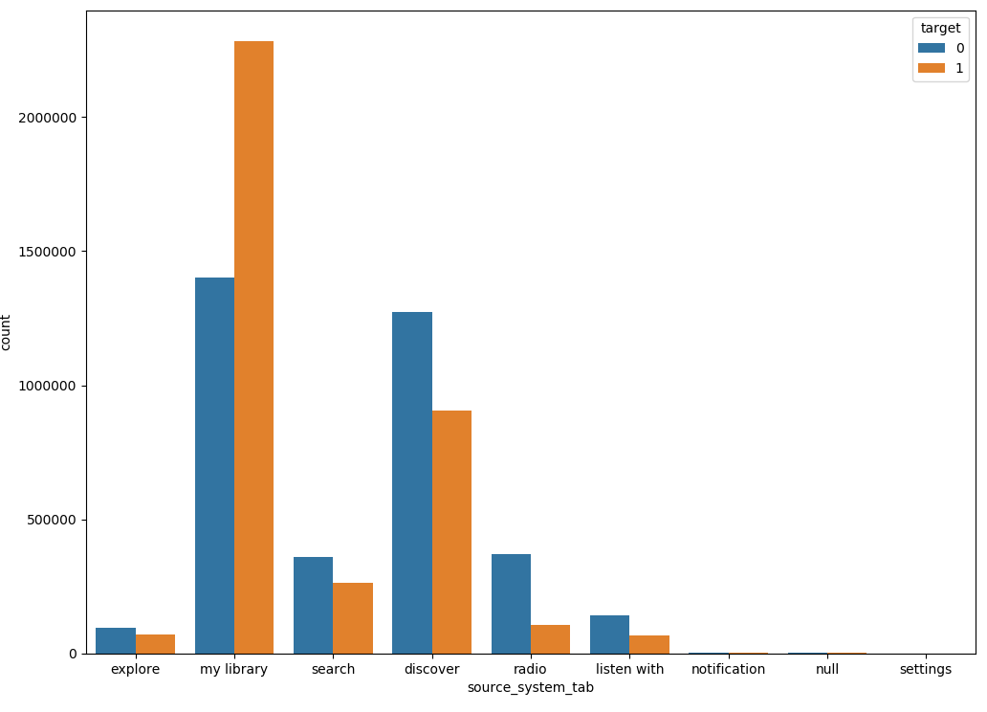
Target by source_system_tab

Slide 3
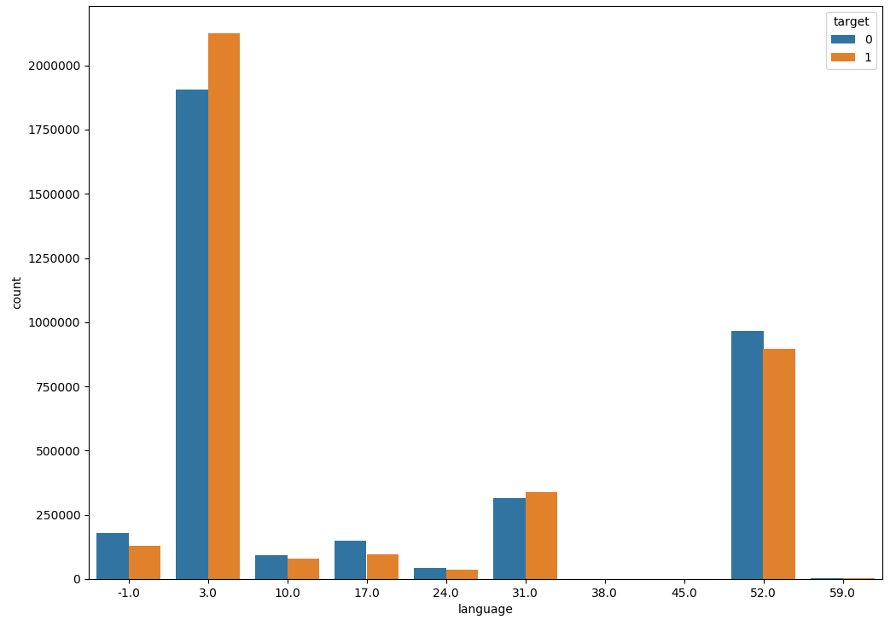
Taiwan
K-Pop
Pop song
Target by languages
Notes:
3.0 is Taiwan music. 52.0 is Pop songs. 31.0 is K-pop

Slide 4
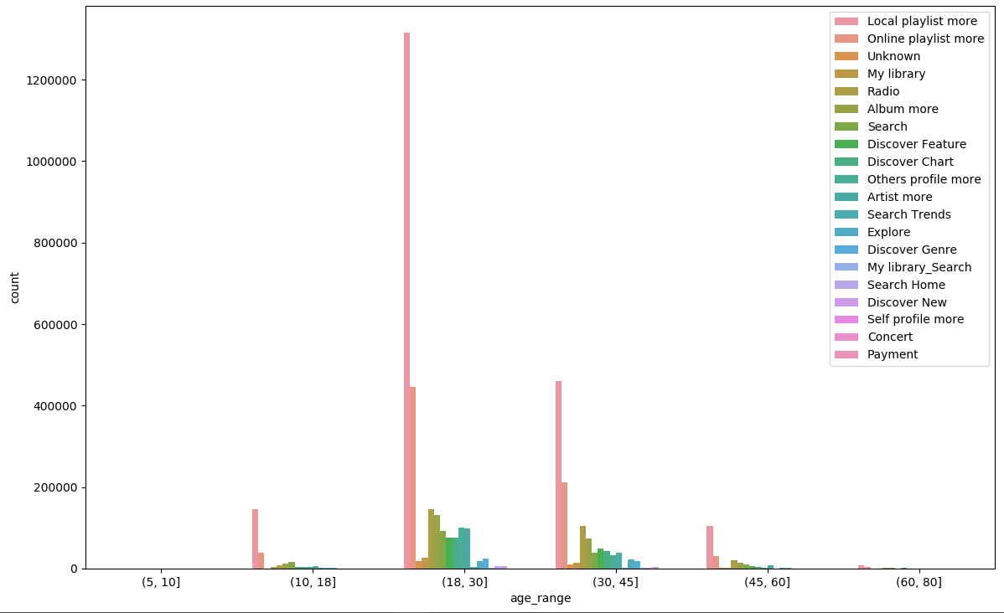
Source_screen_name by age range

Slide 5
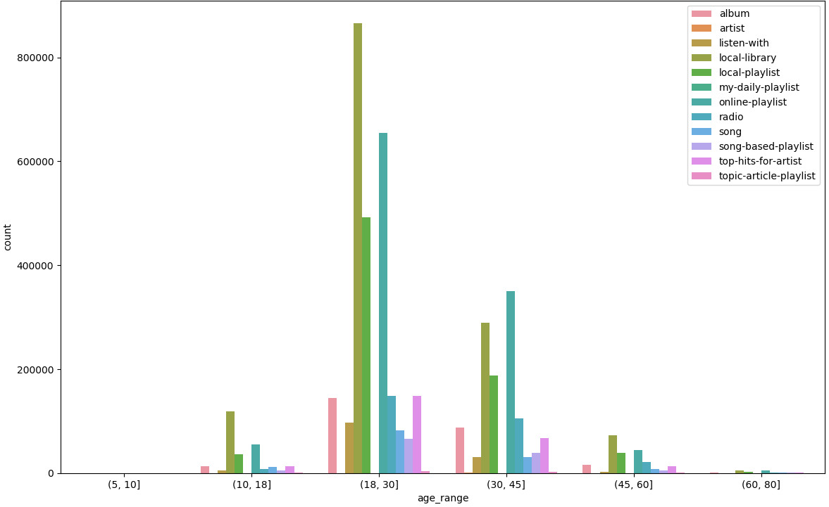
local-library
Online-playlist
Local-playlist
radio
Source_type by age range

Slide 6
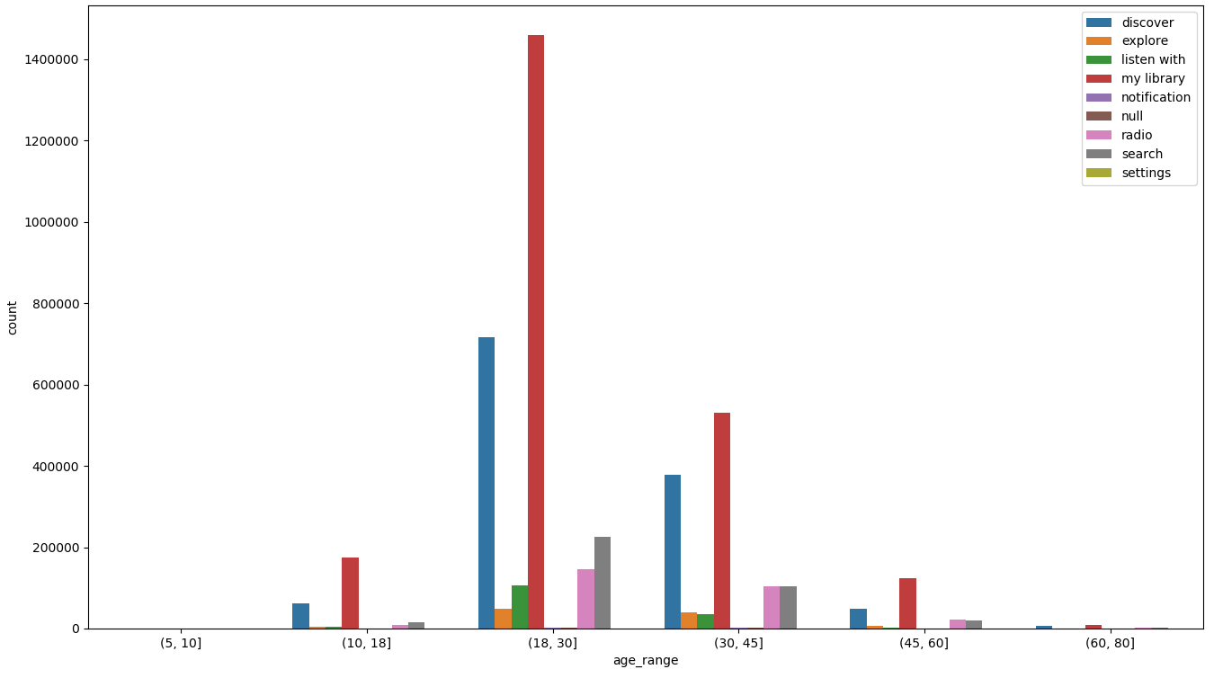
My library
Discover
Search
Radio
Listen with
Source_syetem_tab by age

Slide 7
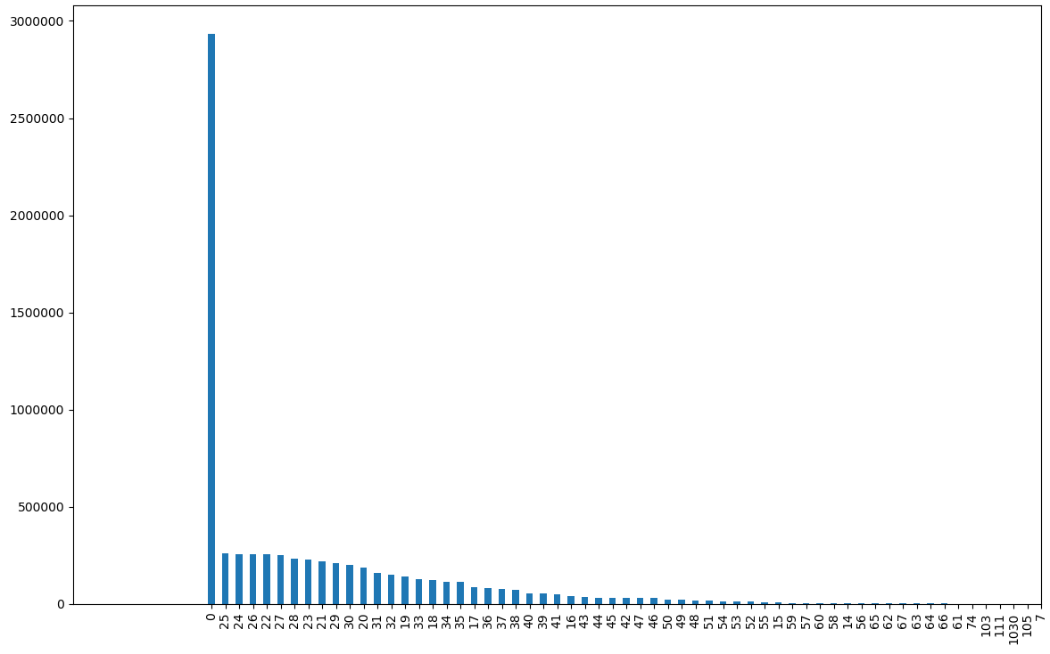
Age 0 is huge!
Age count
Notes:
Amount of age 0 is huge

Slide 8
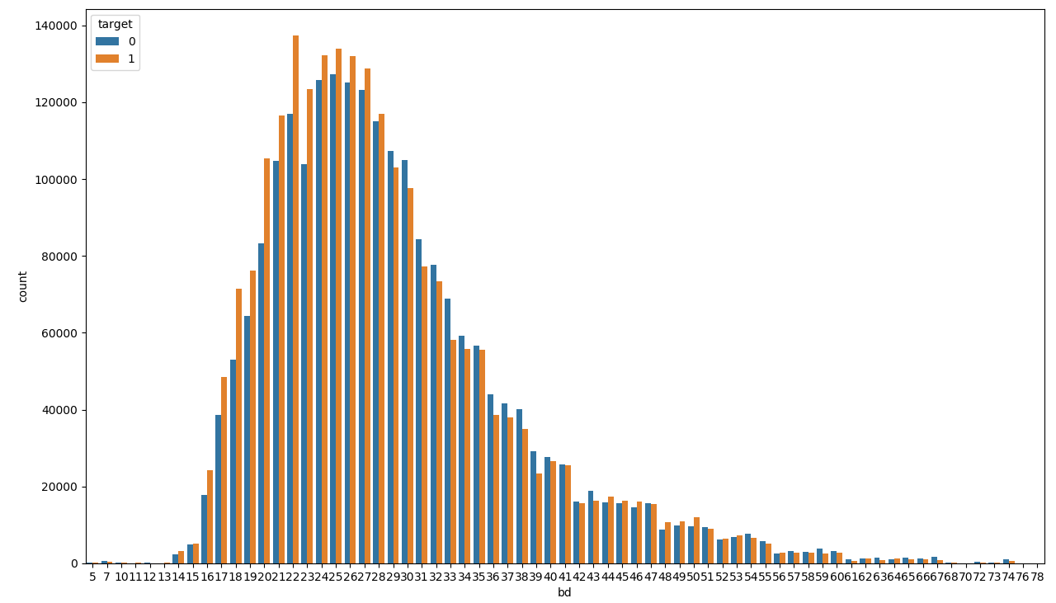
Above age 29, shows that 0 is more than 1
Target by ages

Slide 9
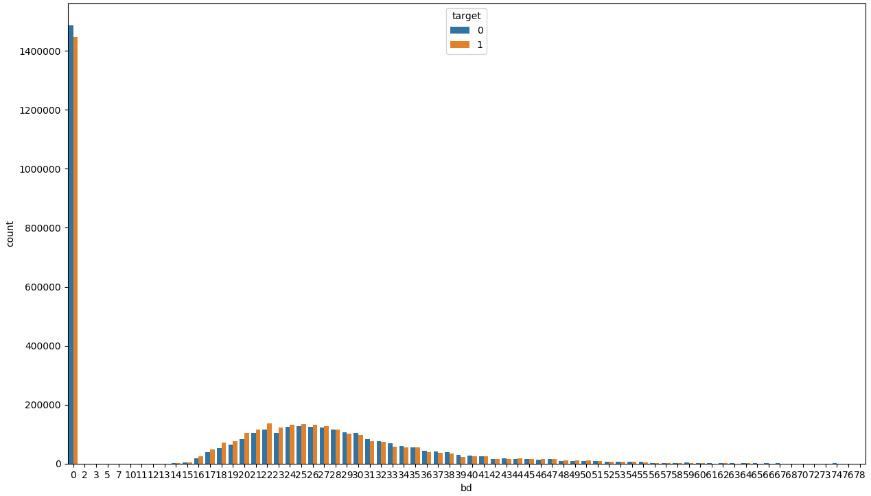
Age 0 is huge!
Target by ages including age 0

